Slide 1
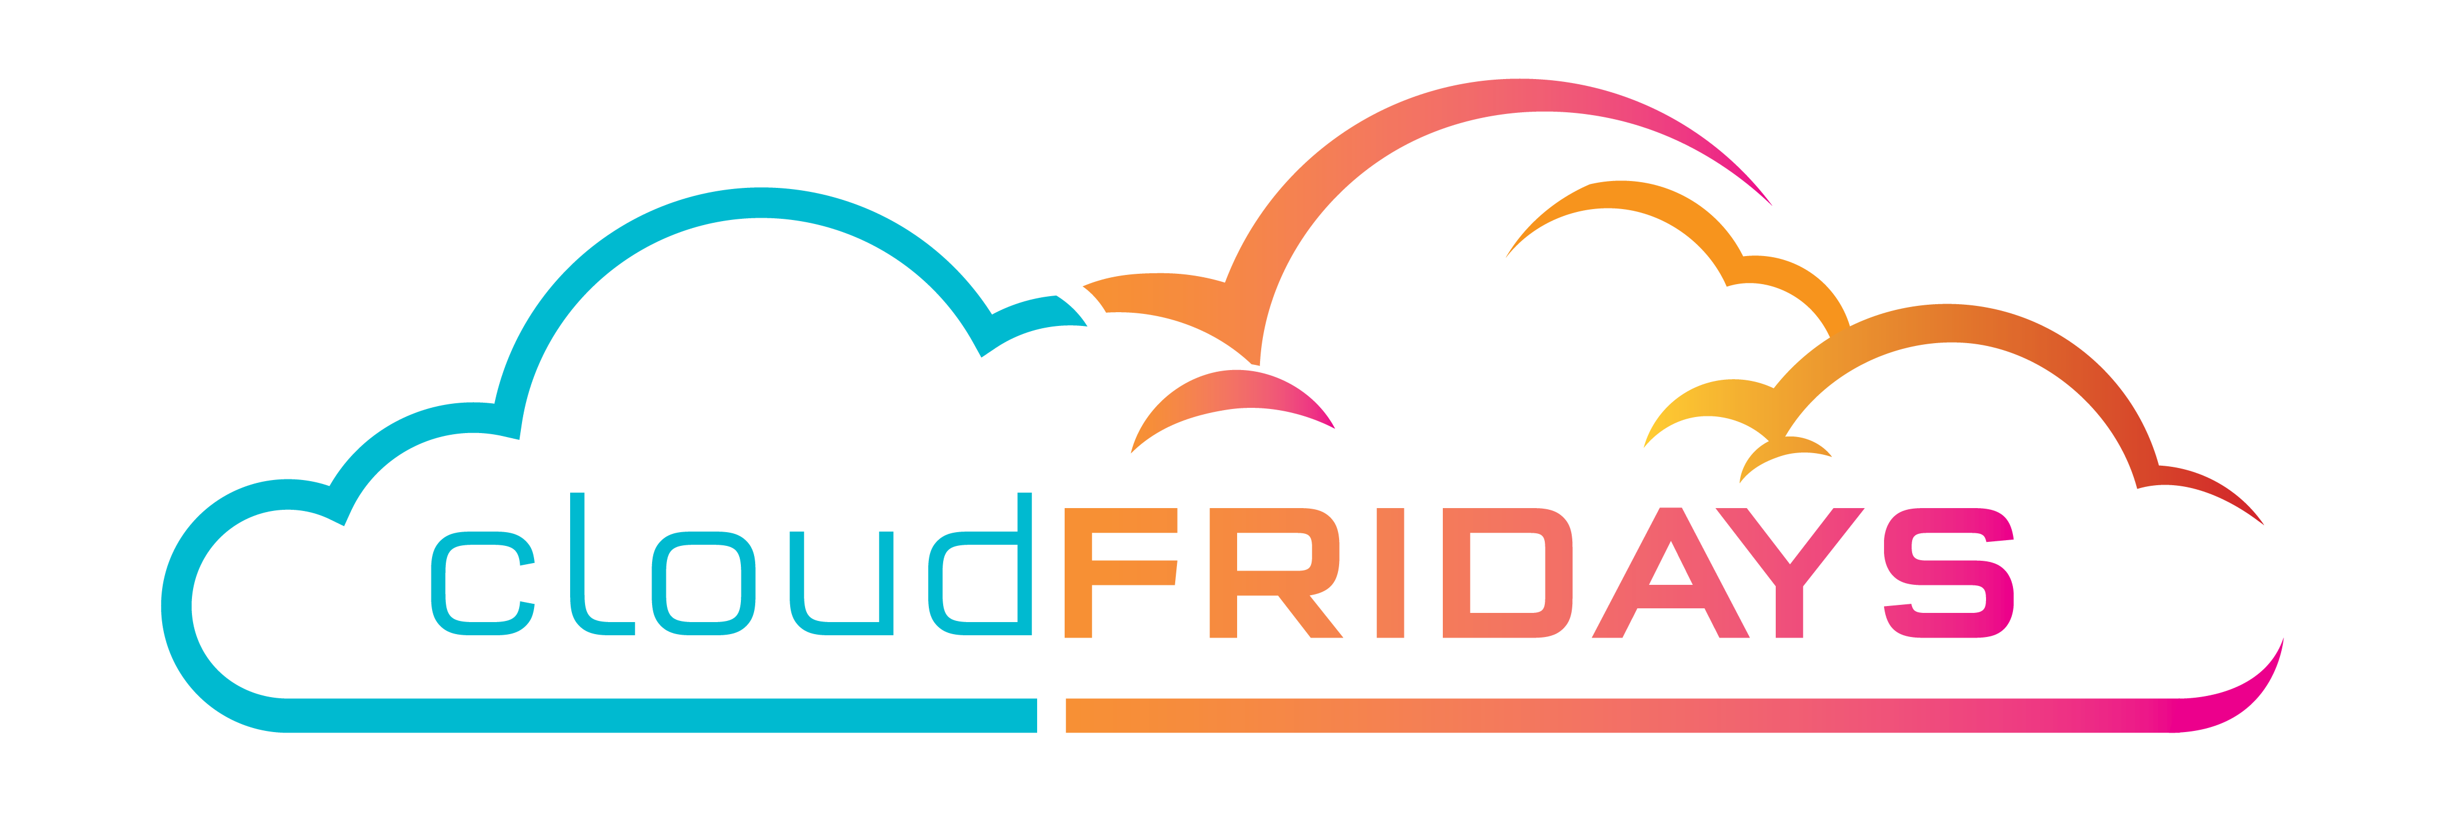

Azure Cost Management
Matthew Levy

Slide 2


Happy “Cupcake” Day

Slide 3
Cloud math is the kind of math that school warned you about:
Mary bought:
2Kg of flour R27.00
500g of butter R75.00
2Kg of sugar R29.00
1 dozen eggs R62.70
2 vanilla pods R110.00
She made:
1 dozen cupcakes
1 small round cake
1 large round cake
2 medium square cakes
Notes:
Let’s go back to we were at school, we all remember the basic math problems, like 2+2 or 5x5
but then things started to get a bit more serious
Mary went shopping and bought ingredients, came home and baked up a storm!

Slide 4
Calculate the cost of one cupcake
Notes:
We then were told to calculate the cost of ONE of the cupcakes??
And often it can feel like this is the type of maths problem we are presented with in cloud computing.
We have this lump sum for our workloads but we really just want to understand what a VM costs.

Slide 5

Usage meters
When you provision an Azure resource, Azure creates one or more meter instances for that resource. The meters track the resources' usage, and generate a usage record that is used to calculate your bill.
Notes:
We start a VM and meters start to tick away, For Example:
Compute Hours
IP Address Hours
Data Transfer In
Data Transfer Out
Disk Operations
Pricing vary per product and often have different pricing tiers based on the size or capacity of the resource.

Slide 6
Factors affecting costs
Resource type
Units and Rate depend on Resource Type
Services
First-party rates vs third-party rates
Location
Popularity, demand, and local infrastructure costs
Billing Zones
Geographical grouping
Notes:
But that’s not all that determines the VM cost, Regions, Disk Type, Licensing, etc have a bearing as well.
Resource Type The usage that a meter tracks and the number of meters associated with a resource depend on the resource type.
Services The Azure team develops and offers first-party products and services, while products and services from third-party vendors are available in the Azure Marketplace . Different billing structures apply to each of these categories.
Location !! potential savings you make from choosing the cheapest location could be offset by the additional cost of transferring data between those resources.
Zones For outbound data transfers (data going out of Azure datacenters), the data transfer pricing is based on Billing Zones.

Slide 7

Zones
Zone | Areas
Zone 1 | United States, US Government, Europe, Canada, UK, France, Switzerland
Zone 2 | East Asia, Southeast Asia, Japan, Australia, India, Korea
Zone 3 | Brazil, South Africa, UAE
DE Zone 1 | Germany
Not to be confused with Availability Zones
Notes:
Availability Zone refers to the failure protection that Azure provides for datacenters

Slide 8
“How much will the Cloud cost?”
Notes:
A common question all customers ask is “How Much will the cloud cost?”

Slide 9
It depends.
Notes:
And in true consultant style the answer really is “It depends”.
Decisions that YOU make about architecture will all effect the over all cost of your cloud spend.

Slide 10
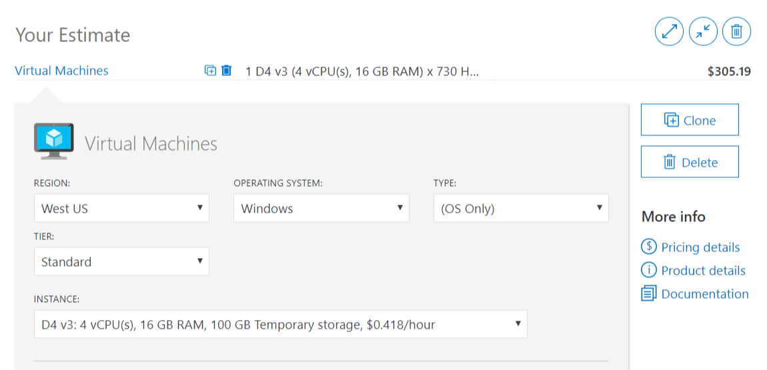
Azure Pricing Calculator (DEMO)
Notes:
We can utilise the Azure Pricing Calculator to help estimate what the cloud spend will be.
https://azure.microsoft.com/pricing/calculator/

Slide 11
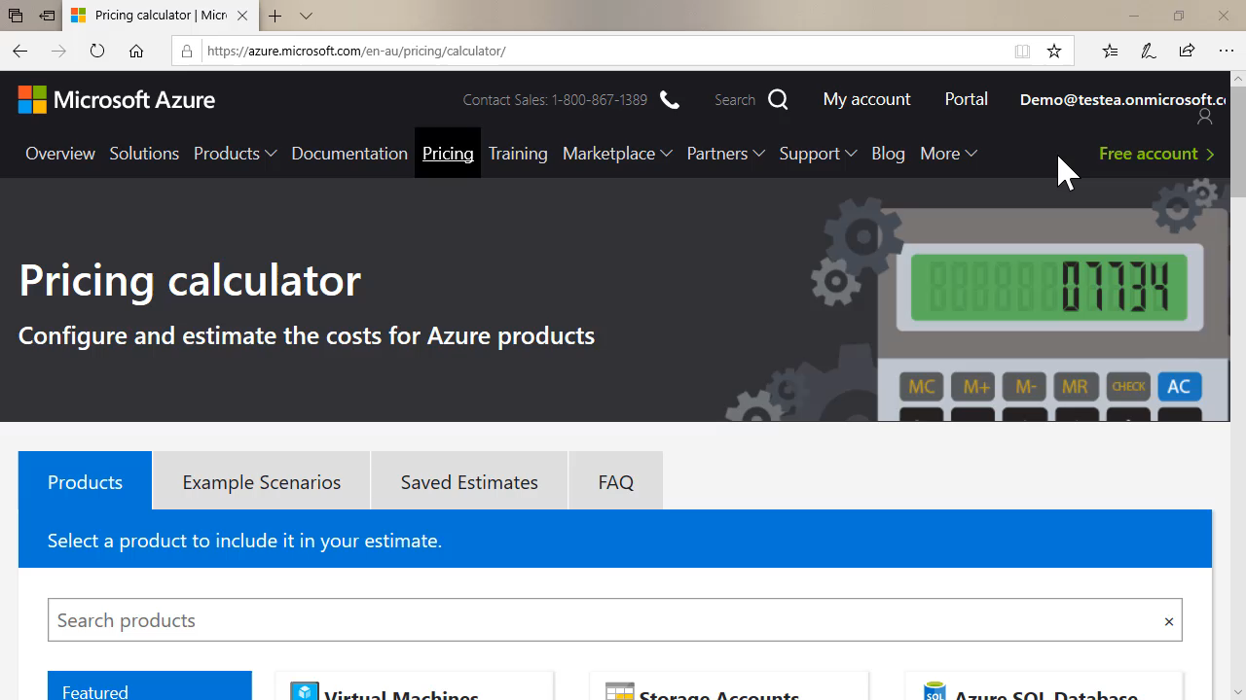
Total Cost of Ownership Calculator
azure.microsoft.com/pricing/tco/calculator/
Notes:
In this demo, we talk about how Tailwind Traders will log into the Azure pricing calculator so they can pull in their Enterprise Agreement pricing, but also if you don’t have an EA how you can log in and use it to save your pricing scenarios.
We demonstrate that you can use the Example scenario tab to see solutions and then price them up.
We then walk through how to price up a VM and about VM tier and instance size. We talk about how we use instances to group machine types together.
We then talk about Reserved Instances and Azure Hybrid Benefit and how it can save money.
We walk through configuring disks and then explain we can save that price configuration or export it.
We’re not done there though as we want to price up a backup for this VM and we take the audience through configuring that.
Explaining about the clone button and how it can be use to duplicate costings for another VM.

Slide 12
Who is responsible for Cloud Cost?
CFO
CIO
CTO
I.T. Manager
I.T. Operations
Developers
Notes:
So who is responsible for this cloud spend? Is it the CFO who is in charge of the company’s purse strings or is it the developer who is deploying the resources?
What we typically find though is that it’s a community effort, everyone within the organisation is responsible for helping to control and understand the costs.

Slide 13
Capital Expenditure (CapEx)
Financial considerations
Operational Expenditure (OpEx)
Asset appears on Balance Sheet
Increases business value
Reduces taxes via depreciation
Cost appears on Profit & Loss Statement
Directly reduces net profit
Reduces income subject to tax
Notes:
When your C-level executives are thinking about cloud v on-prem costs it can be a complicated matter with lots of things for them to think about.
Let’s delve back into the Maths/accountancy field for a bit.
When you buy physical hardware for your own datacentre that will appear as an asset on your company’s balance sheet. But when you buy something from the cloud it will appear as a line on your profit & loss statement.
Having the physical hardware on your books can increase your business value, as you own that. In the cloud however that spend can reduce your net profit.
But that can have a benefit as you’ll be subject to less tax on your income. And equally due to the hardware depreciation your taxes will be reduced as well.
So there is a lot to consider for your C-level executives when it comes to on-prem v cloud.

Slide 14
“Will the Cloud be cheaper?”
Notes:
Another common question by customers is “Will the cloud be cheaper?”

Slide 15
Tailwind Traders wants to migrate 3 physical Windows Server 2008 R2 servers to the Cloud. Will this be cheaper than operating them on-premises over the next 2 years?

Slide 16
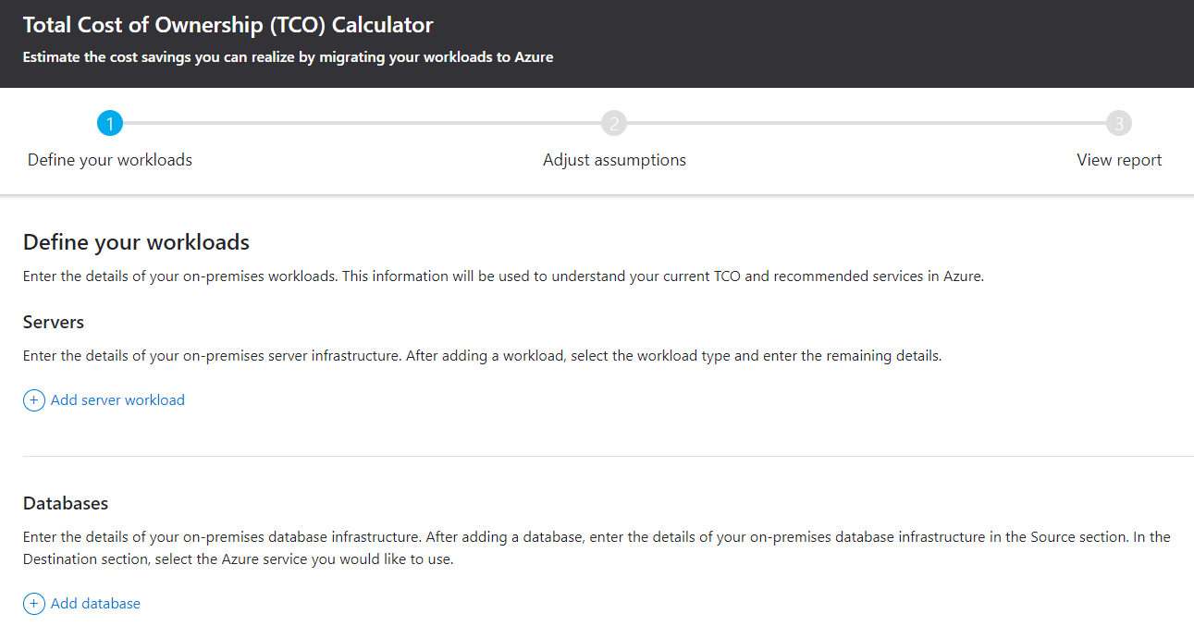
Azure Total Cost of Ownership Calculator (DEMO)
Notes:
The Azure Total cost of Ownership calculator, can help to compare your on-prem costs versus what you want to use in the cloud.
https://azure.microsoft.com/pricing/tco/calculator

Slide 17
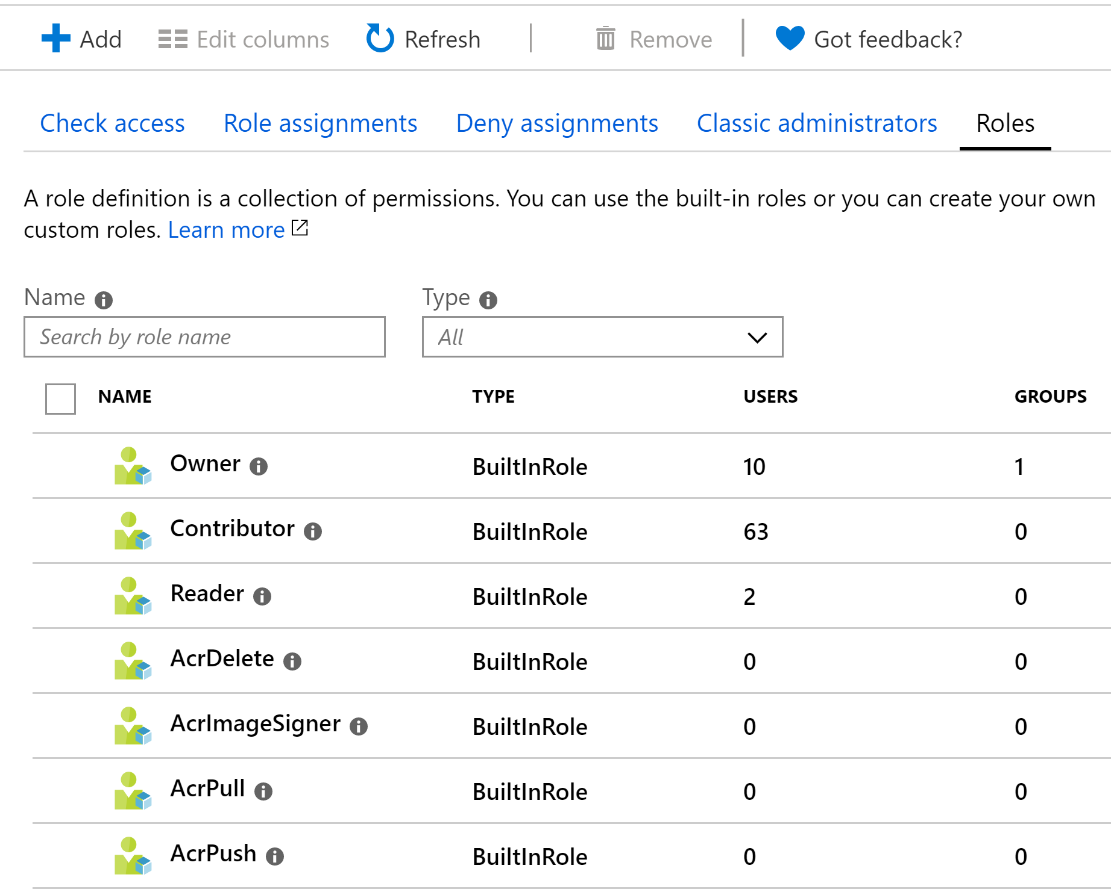
Role Based Access Control
Categorize resources across different resource groups and subscriptions
for billing, management, and operational purposes.
Identify common tags (such as CostCenter, ApplicationOwner)
Apply them consistently using automation & Azure Policy.
Restrict who has access to create resources
Define who has access to cost data
Notes:
Role Based Access Control can be used to restrict who can create resources and in terms of cost, remember I said it takes a community to control and track cloud spend? We want to give our financial team access to that data but not the ability to create/delete resources so we can do that via RBAC

Slide 18
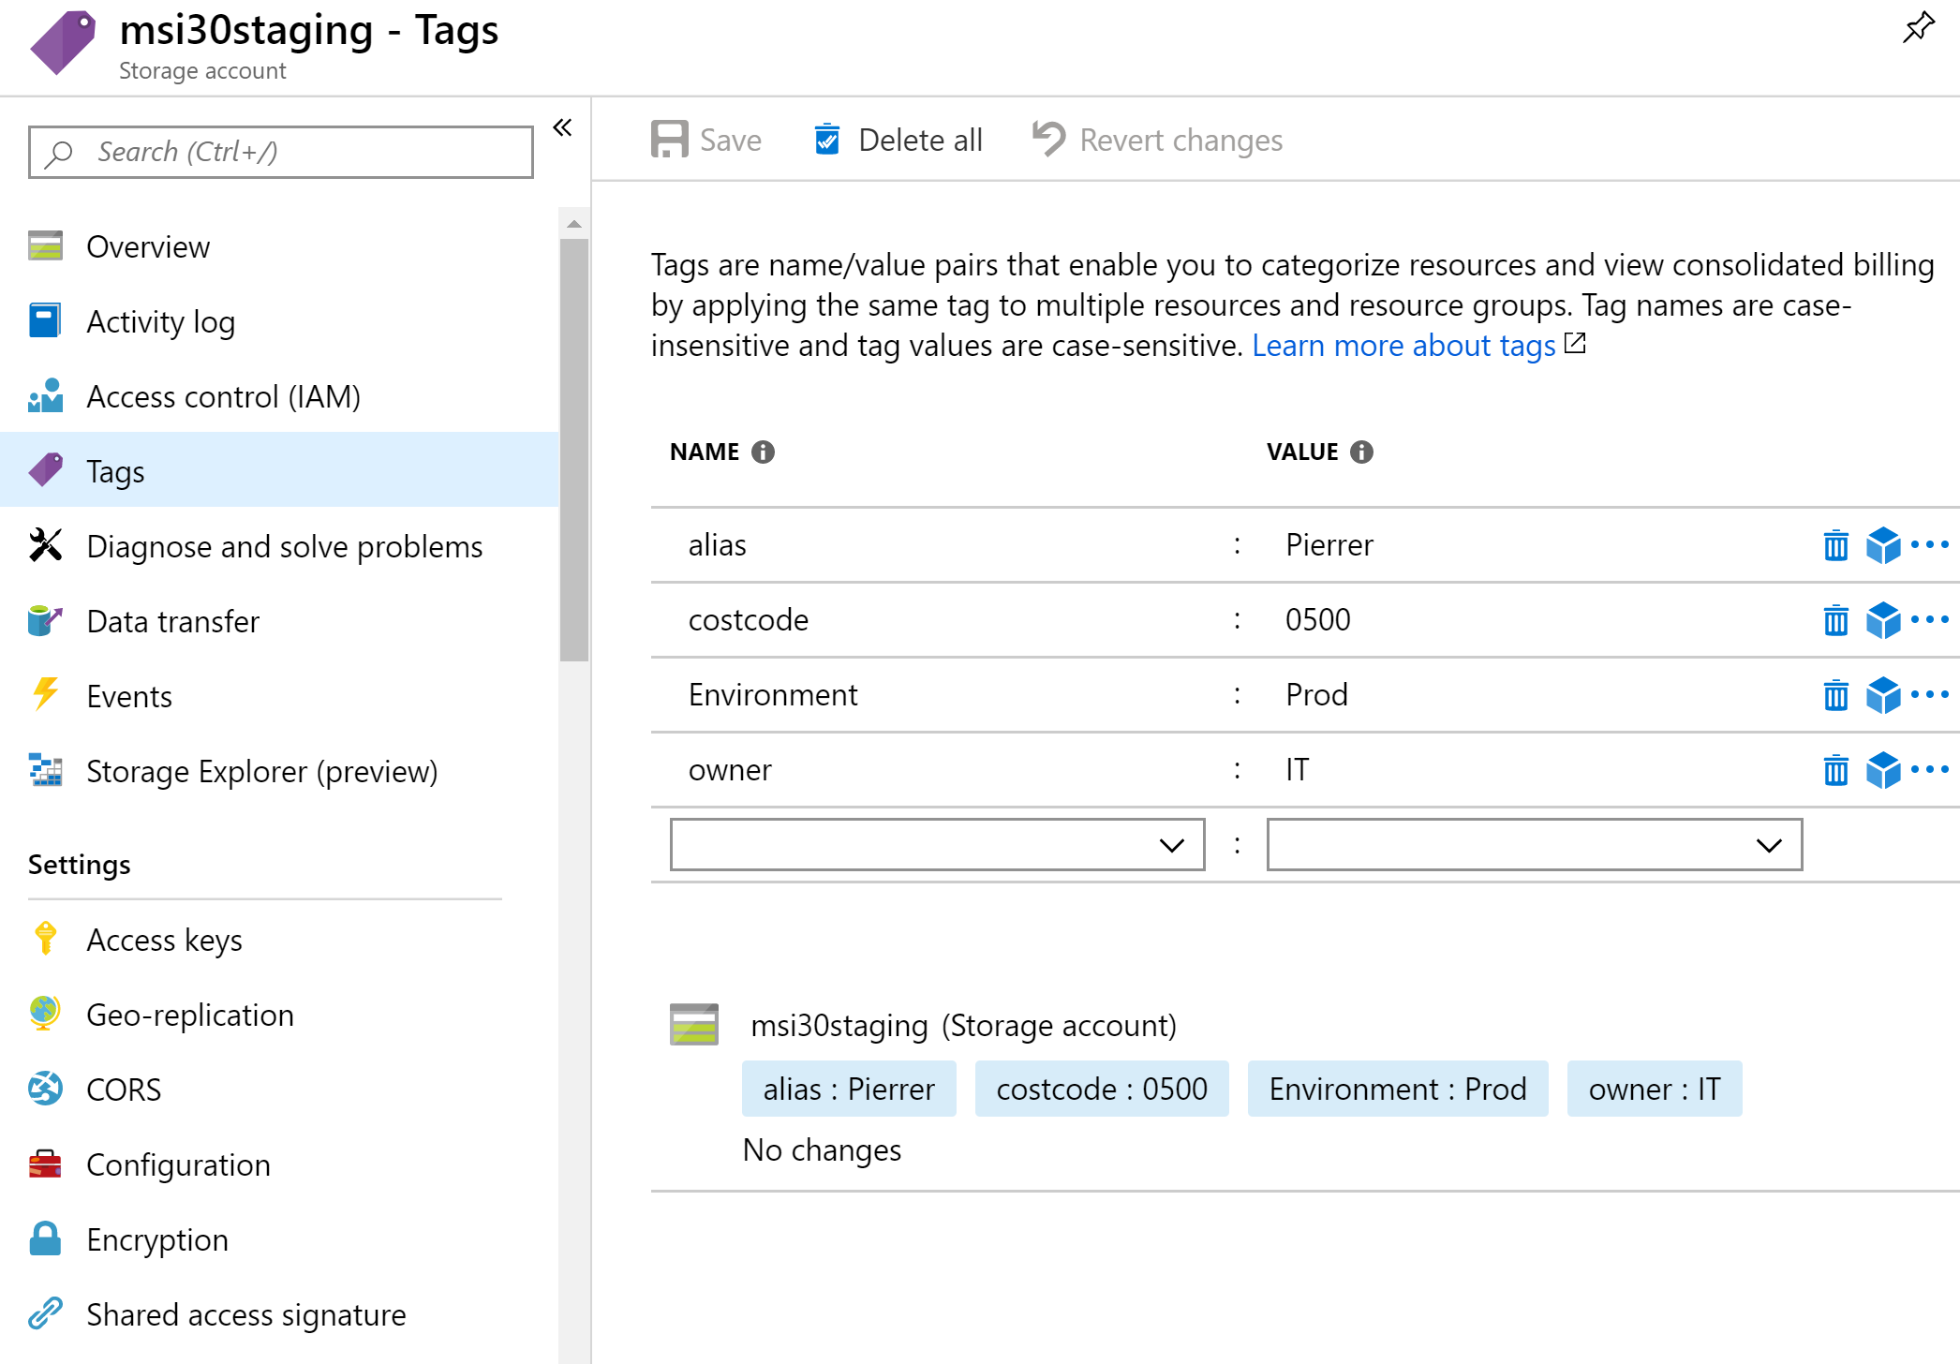
Resource tags
Categorize across different resource groups and subscriptions
Identify common tags (such as CostCenter, Environment)
Portal, Templates, PowerShell, Azure CLI, REST API
Enforce usage with Azure Policy
Categorize resources across different resource groups and subscriptions
for billing, management, and operational purposes.
Identify common tags (such as CostCenter, ApplicationOwner)
Apply them consistently using automation & Azure Policy.
Notes:
Tags are super important and here in cost management, we want to tag things with the environment they belong to, so we can track spend within that environment (production v development) and also even use cost centres, so we can cross charge things back to other departments and not have the IT department pay for everything.

Slide 19
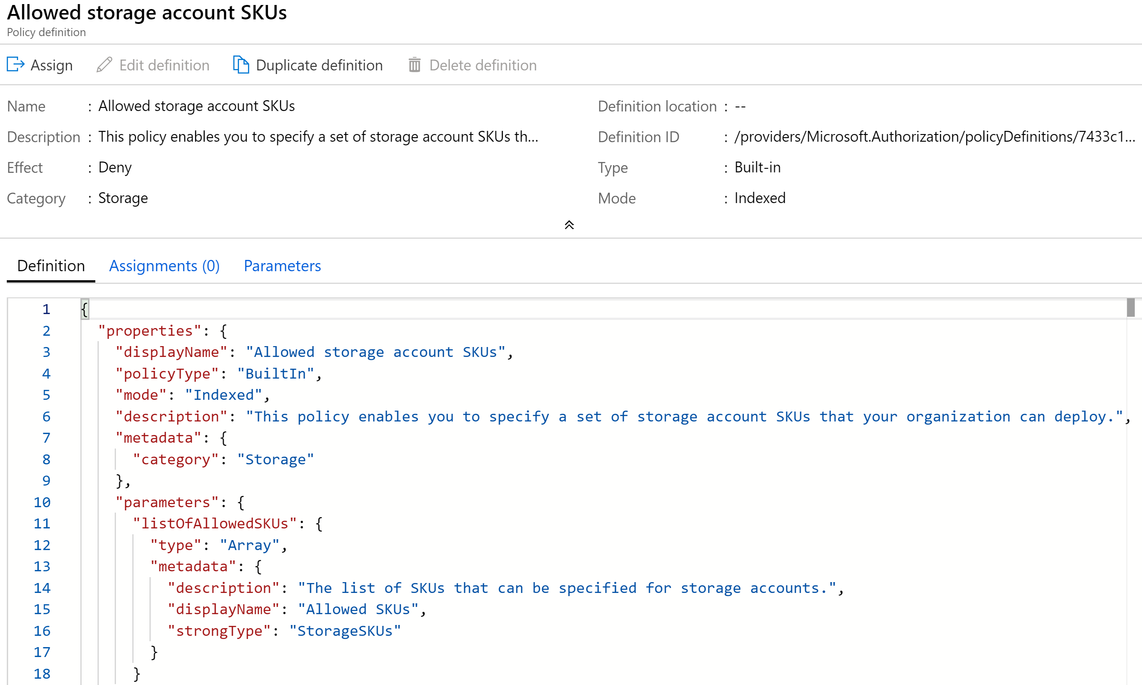
Azure Policy
Categorize resources across different resource groups and subscriptions
for billing, management, and operational purposes.
Identify common tags (such as CostCenter, ApplicationOwner)
Apply them consistently using automation & Azure Policy.
Restrict expensive SKUs
Apply Tags
Notes:
Because we are all human and can forget to do things we can use Azure Policy to help enforce our tags across our resources. Or we can use it to restrict the expensive SKUs, we don’t want to accidently spin up one of those VMs that are great for video editing but can cost up to $5,000 a month!

Slide 20
“How will we know if we’re spending too much, BEFORE we get the invoice?”
Notes:
Keeping track of what your spend is and making sure you don’t overspend before the bill comes in is always important.

Slide 21
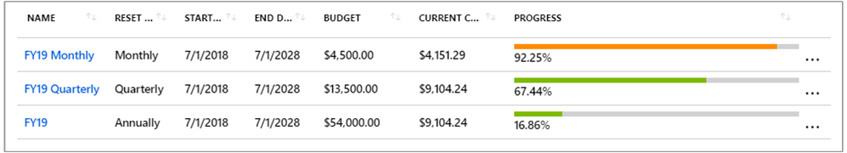
Azure Budgets (DEMO)
https://msit.microsoftstream.com/video/39f5193c-4396-4332-abc3-c492e3a4f5c3?channelId=b9f7d4d3-e1c8-4804-b914-1b4098ac5997
https://msit.microsoftstream.com/video/39f5193c-4396-4332-abc3-c492e3a4f5c3?channelId=b9f7d4d3-e1c8-4804-b914-1b4098ac5997
Notes:
This is where Azure Budgets can help. They can give you a sense of where you are for that billing period and help you be proactive if you are going to overspend what you forecasted.

Slide 22
“Where are all of our costs coming from?”
Notes:
Where did we spend all our money is the cry when the bill comes in right?

Slide 23

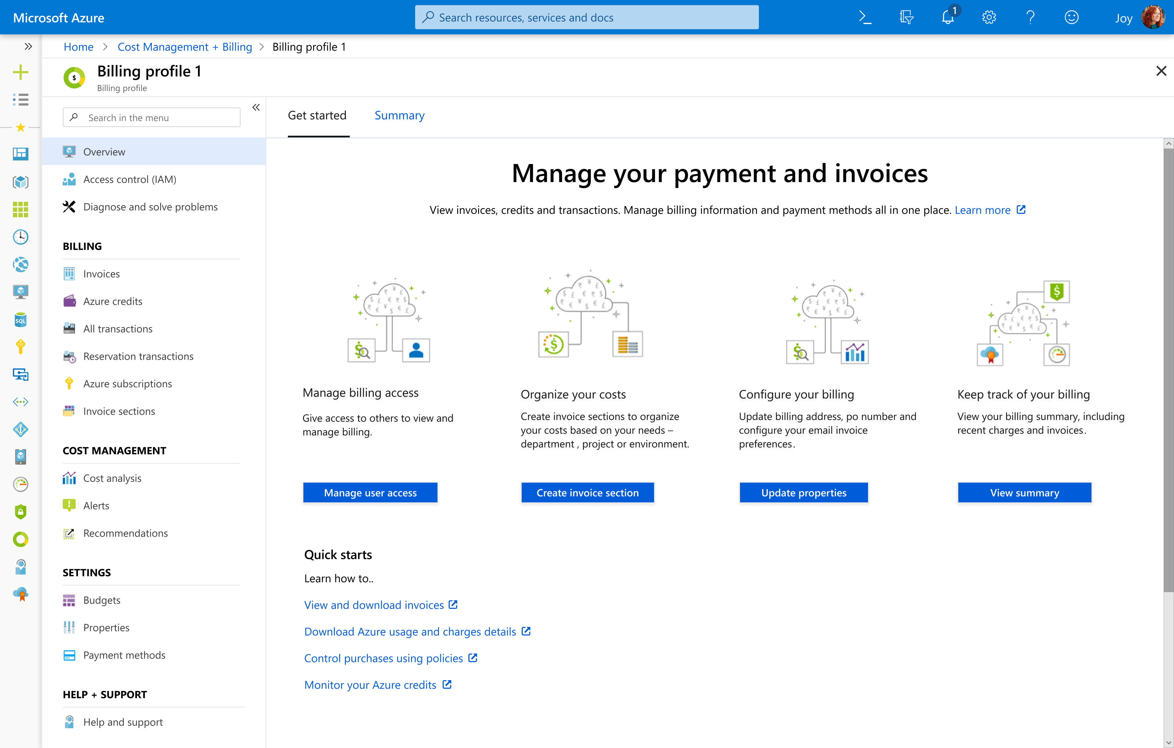
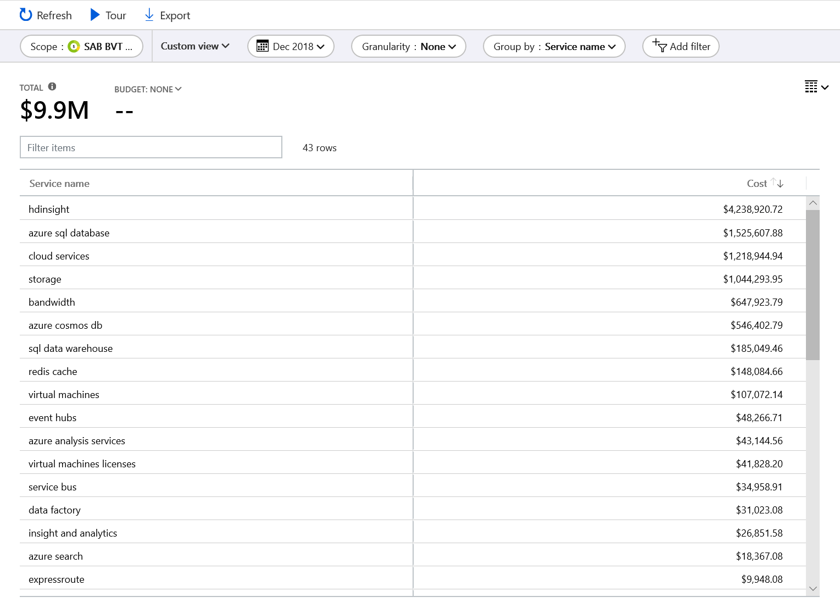
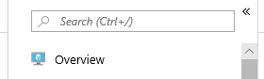
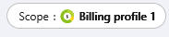
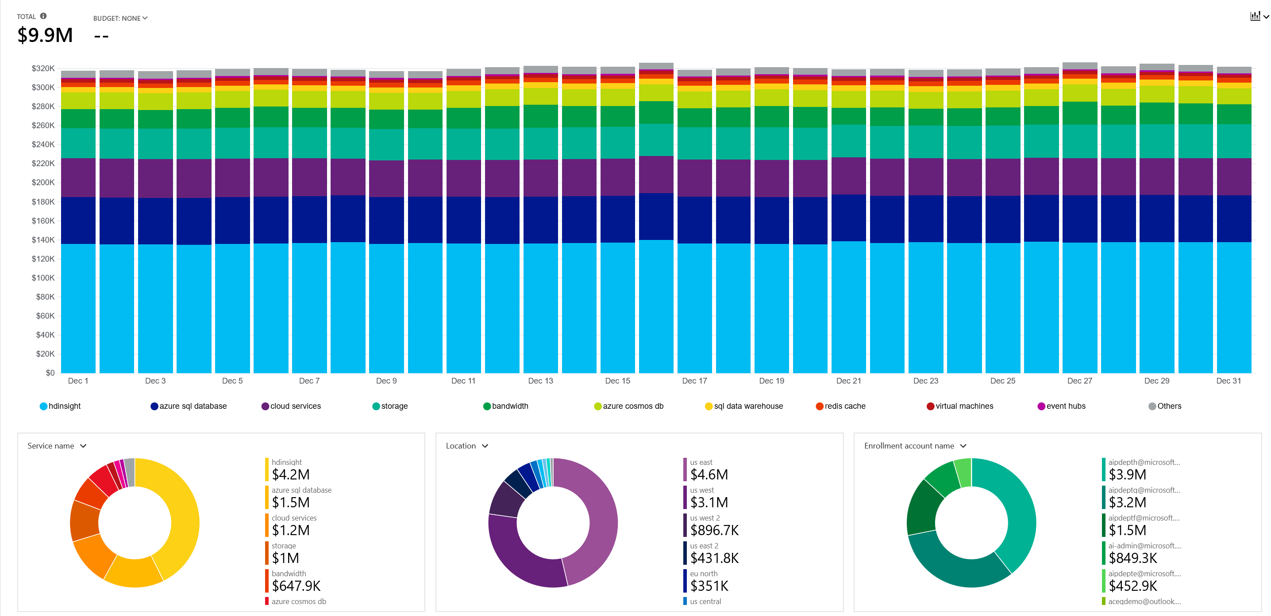
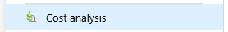
Azure Cost Analysis (DEMO)
Notes:
This is where Azure Cost Analysis can come in handy as we can view our costs and break it down to understand the areas of high spend.

Slide 24
“Can we save any money?”
Notes:
Now that you understand the monthly bill, the cry is “Can we save any money?”

Slide 25
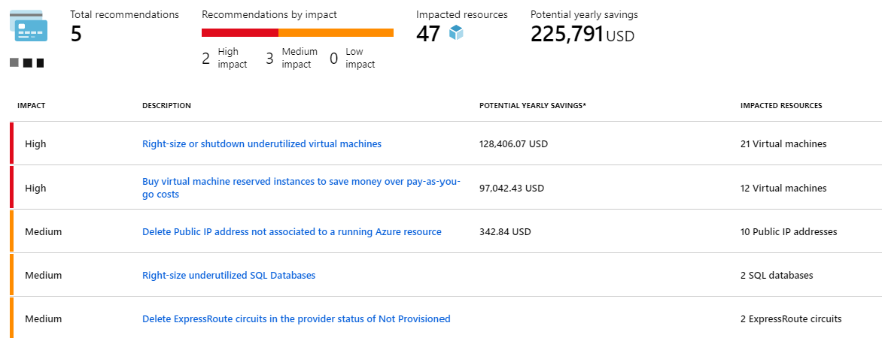
Azure Advisor
Notes:
Azure Advisor is a great service built into Azure that gives out a series of recommendations on different categories and costs savings is one of those areas.

Slide 26
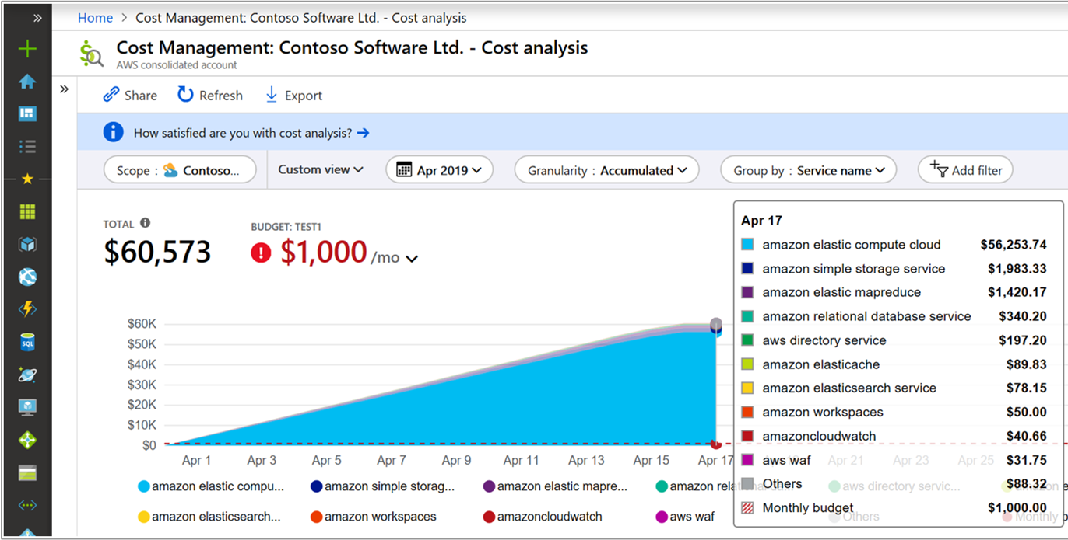
AWS Cost Data via Azure Cost Management
https://docs.microsoft.com/azure/cost-management/aws-integration-set-up-configure?WT.mc_id=twitter-social-socuff
https://docs.microsoft.com/azure/cost-management/aws-integration-manage?WT.mc_id=twitter-social-socuff
Notes:
Recently announced was the fact that you can now monitor your AWS spend within Azure Cost Management, it does come with a small charge, 1% of your AWS spend.

Slide 27
The key takeaway is that resources are always charged based on usage. For example, if you de-allocate a VM then you will not be billed for compute hours, I/O reads or writes or the private IP address since the VM is not running and has no allocated compute resources. However you will incur storage costs for the disks.
Note
De-allocating a VM is not the same as deleting a VM. De-allocation means the VM is not assigned to a CPU or network in a datacenter. However, your persistent disks remain, and the resource is present in your subscription. It's similar to turning off your physical computer.

Slide 28
Cost Management tools in Azure
Tool | Azure portal | Azure Cost Management | Azure EA Content Pack | Azure Policy
Enterprise Agreement required? | No | No | Yes | No
Budget control | No | Yes | No | Yes
Monitor spending on single resource | Yes | Yes | Yes | No
Monitor spending across multiple resources | No | Yes | Yes | No
Control spending on single resource | Yes - manual sizing | Yes | No | Yes
Enforce spending across multiple resources | No | Yes | No | Yes
Enforce accounting metadata on resources | No | No | No | Yes
Monitor and detect trends | Yes | Yes | Yes | No
Detect spending anomalies | No | Yes | Yes | No
Socialize deviations | No | Yes | Yes | No

Slide 29
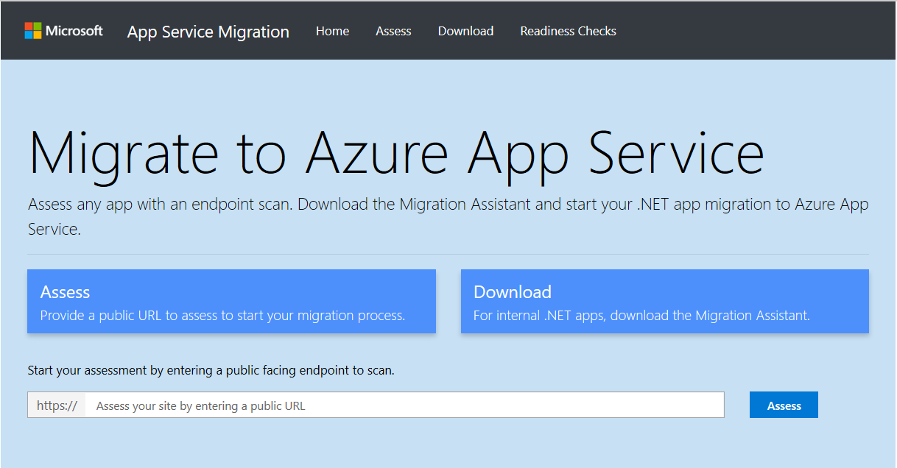
Appmigration.microsoft.com
Notes:
Other tools that can help Tailwind Traders assess, and understand how to move their workloads to the cloud are things like the App Service Migration tool. Which can help assess public facing .NET and PHP Apps and feedback if and how they can be moved to the cloud.

Slide 30
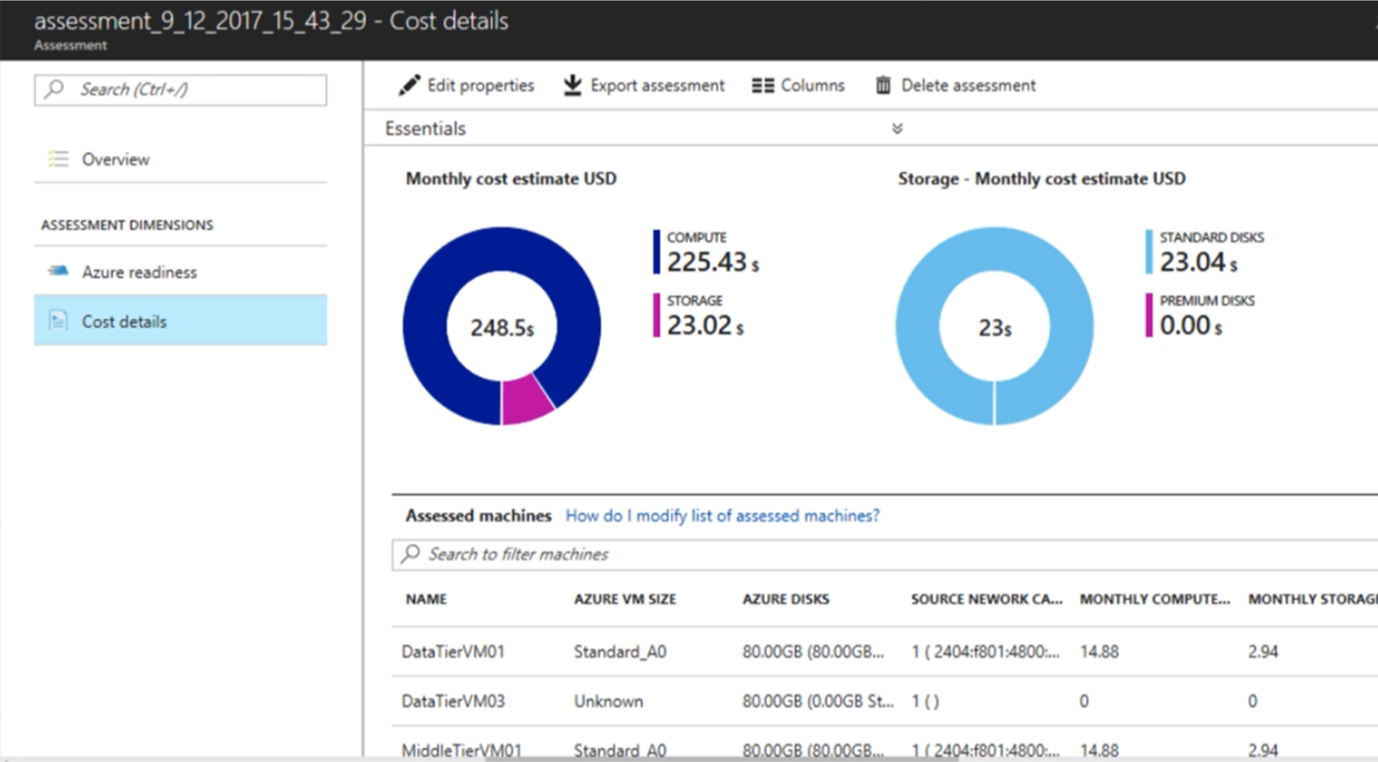
Azure Migrate
On-prem VMware VMs
Hyper-V VMs
Notes:
Azure Migrate is the tool that can be used to assess, price up and migrate your on-prem vmware vms and hyper-v VMs. The tool is pretty powerful and here at Ignite Orlando there is a session dedicated to it in the form of MSI30.
More details at cda.ms/SM

